Slide 1
Perspectives of imaging of single macromolecular complexes at the European XFEL
Evgeny Saldin

Slide 2
Requirements for bio-imaging
European XFEL publicity image shows single macromolecular complex imaging with atomic resolution (www.xfel.eu/media/), but this is not possible with present design!
The imaging method “diffraction before destruction” requires pulses containing enough photons to produce measurable diffraction patterns and short enough to outrun radiation damage
The highest signals are achieved at the longest wavelength that supports the resolution, which should be better than 0.3 nm
Ideal wavelength range for single molecule imaging spans 3 to 5 keV
(H. Chapman, J. Hajdu in LCLS-II New Instrument Workshop rep.)

Slide 3
Requirements for bio-imaging
The higher intensity, the stronger the diffracted signal, and the higher the resolution that can be achieved.
Required fluence is 10²² photons/mm² for molecule of about 10 nm size
Bio-imaging capabilities can be obtained by reducing the pulse duration to 10 fs or less and simultaneously increasing the number of photons per pulse to about 10¹⁴ . This gives required fluence (with 100 nm focus assuming beamline and focusing efficiency)
Key metric is photon power. Ideally ~ 10 TW
(10¹⁴ photons at ~3.5 keV is ~ 60 mJ and in 10 fs ~ 6 TW)
1 TW at 3 keV gives the same signal per Shannon pixel as ~ 20 TW at 8 keV
(assuming fixed pulse duration)

Slide 4
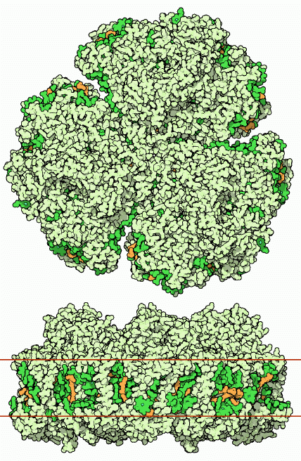
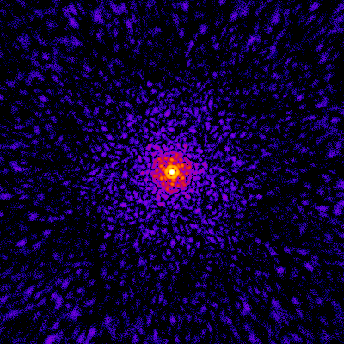
Calculated scattering from a single photosystem-I molecule
We confirm by simulations that, with 10¹⁴ photons per 10 fs pulse at 3.5 keV photon energy in a 100 nm focus, one can achieve diffraction to the desired resolution. This is exemplified using photosystem-I membrane protein as a case study
Simulated diffraction pattern from photosystem-I for fluence 10²² photons/mm². The simulation was performed for 3.5 keV radiation, neglecting radiation damage
Courtesy of S. Serkez and O. Yefanov

Slide 5
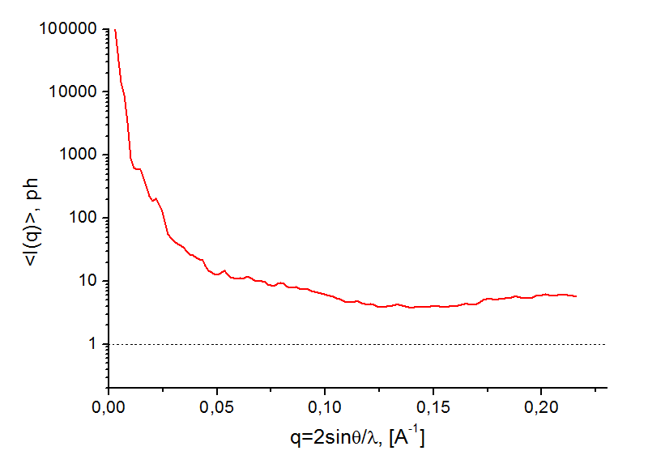

Calculated scattering from a single photosystem-I molecule
Radially averaged scattered intensity as a function of scattering vector S for the photosystem-I illuminated with 0.35 nm radiation
Distance 100 mm
Sensor full size 200 mm
Pixel size 0.5 mm
Resolution (pixels) 400
<I(S)>, ph
$$S=2\sin{θ/λ}$$

Slide 6
Calculated scattering from a single photosystem-I molecule
Full 3D information requires combining many diffraction patterns. For identical
objects, each pattern corresponds to a different orientation of the object. Combining data from many patterns of the same orientations of an identical object is also needed to increase the overall signal.
Key metric is the number of photons per pixel per (single shot) pattern.
We see from our calculated diffraction pattern that most detector pixel values are considerably higher than one photon count up to resolution approaching
0.3 nm
Detector pixel value > 1 photon/pixel resulting in an increase in number of classified images (i.e. determined with point of view orientation) up to the number of hits
For a molecule of 10 nm size one needs ~ 10² evenly spread 2D projections to get a geometrical resolution of 0.3 nm. Thus for fluence 10²² photons/mm² , number of images ~ 10⁴ is required to achieve full 3D information.

Slide 7
Perspectives of imaging of single molecules with present design of European XFEL
According to the present design of EXFEL, (SASE) power saturates at ~ 50 GW. This is very far from 10 TW-power level required for imaging of single bio-molecules.
Conclusion: There are no perspectives of imaging of single bio-particles with present design of European XFEL.
There is an urgent need to improve design, before it is too late!
There is cost-effective way to improve the output power:
Self-seeding and undulator tapering greatly improves FEL efficiency
Cost of self-seeding setup with single crystal monochromator is ~ 2 MEUR. Undulator tapering is based on the used the baseline tunable gap undulator and can be implemented without additional cost.

Slide 8
10 TW-power level undulator source
We propose to use the simplest configuration combining self-seeding and undulator tapering techniques with emittance-spoiler method.
Last year experiments at the LCLS confirmed the feasibility of all these three new techniques.
We use the current profile, the normalized emittance, the energy spread profile, the electron beam energy spread, and the resistive wakefields in undulator from “Compression Scenarious for the European XFEL” Igor Zagorodnov DESY 14 April 2012

Slide 9
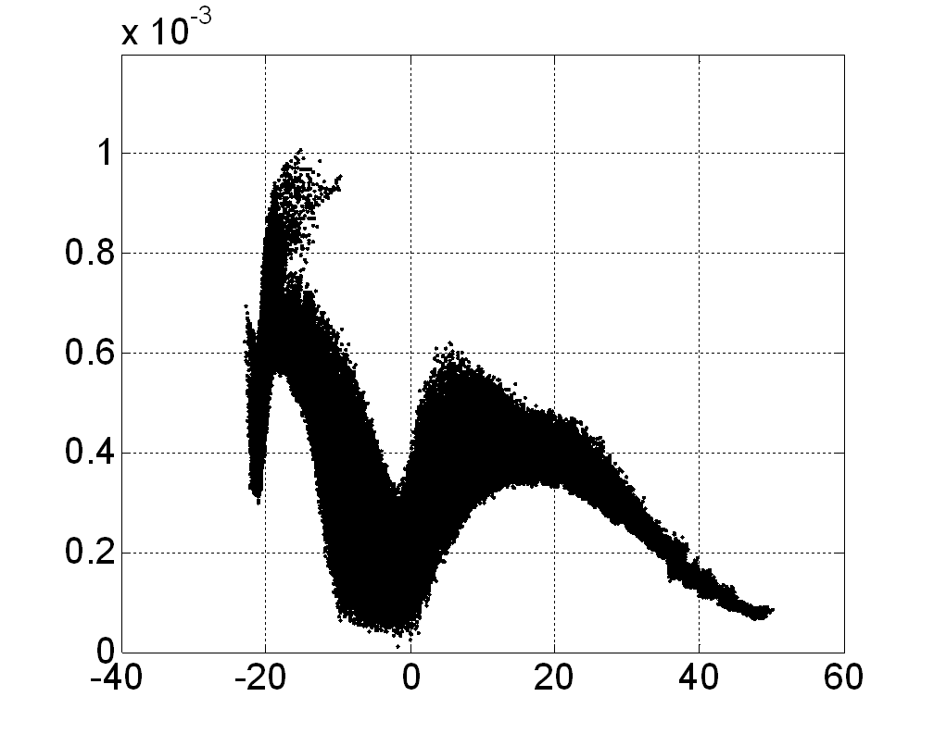
Strong compression for 1 nC charge
Q=1 nC, I=10kA
Phase space
Current, emittance, energy spread
Courtesy of I. Zagorodnov

Slide 10
X-ray pulse length control from a slotted foil in the last bunch compressor
y
PRL 92, 074801 (2004).
P. Emma, M. Cornacchia, K. Bane, Z. Huang, H. Schlarb, G. Stupakov, D. Walz (SLAC)
coulomb scattered e⁻
e⁻
unspoiled e⁻
coulomb scattered e⁻
x ∝ ΔE/E ∝ t
2Δx
3-μm thick Al foil

Slide 11
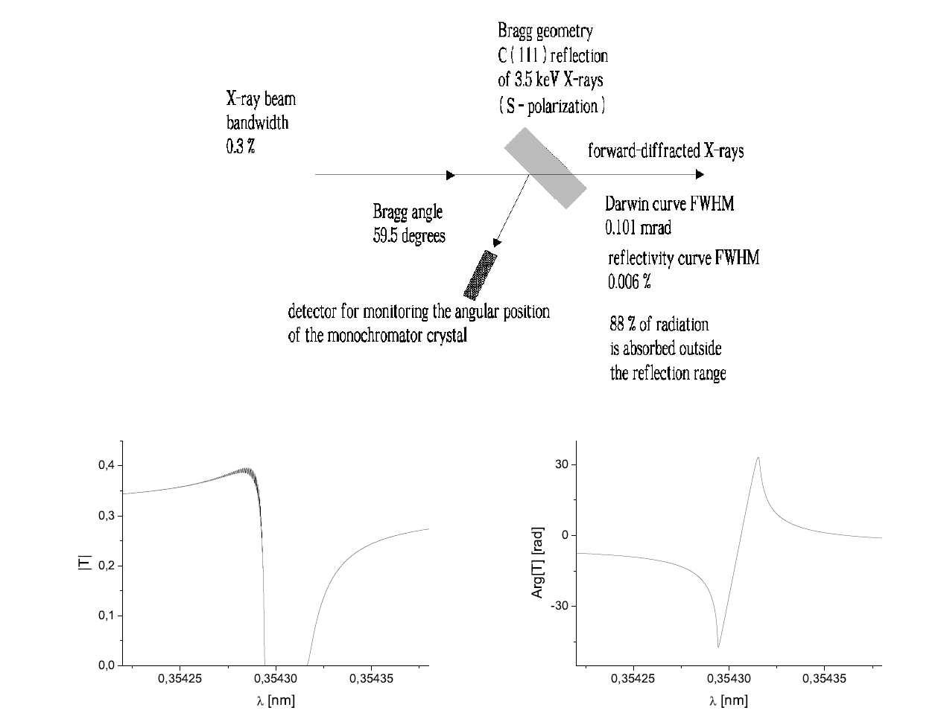
Scheme of 10 TW-power level undulator source
11
It is feasible to approach 10 TW-power level with baseline EXFEL undulator
Self-seeding and undulator tapering greatly improves FEL efficiency
X-ray pulse length control from a slotted foil
7 cells
(uniform)
8cells
(uniform)
25 cells
(tapered)
Hard X-ray self-seeding scheme with single-crystal monochromator can be used around 4 keV photon energy range
Notes:
11
Before you start editing the slides of your talk change to the Master Slide view:
Menu button “View”, Master, Slide Master:
Edit the following 2 items in the 1st slide:
1) 1st row in the violet header:
Delete the existent text and write the title of your talk into this text field
2) The 2 rows in the footer area: Delete the text and write the information
regarding your talk (same as on the Title Slide) into this text field.
If you want to use more partner logos position them left
beside the DESY logo in the footer area
Close Master View

Slide 12
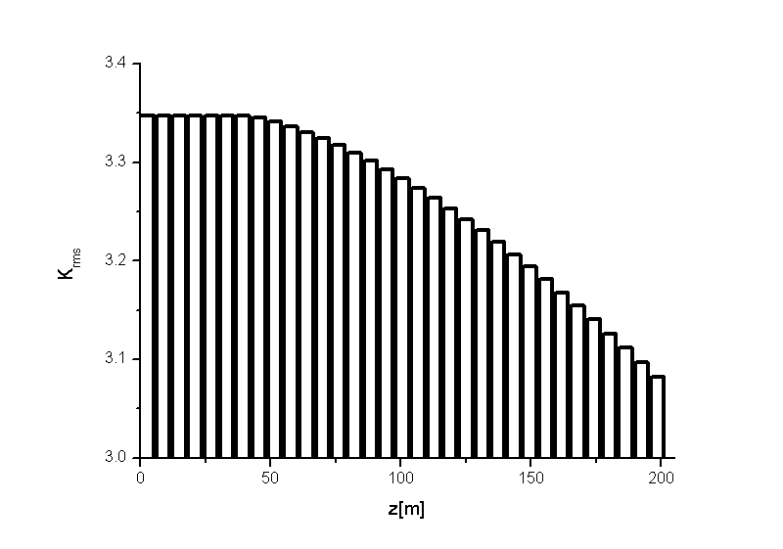
FEL simulations
12
After the electron beam passes through the emittance-spoiling foil, one unspoiled time slice with good emittance will contribute to FEL lasing. Following the self-seeding setup, the electron bunch amplifies the seed in the last part of undulator. It is partly tapered post saturation, to increase the efficiency. Tapering is implemented by changing the K parameter of the undulator segment by segment according to tapering law
Notes:
12
Before you start editing the slides of your talk change to the Master Slide view:
Menu button “View”, Master, Slide Master:
Edit the following 2 items in the 1st slide:
1) 1st row in the violet header:
Delete the existent text and write the title of your talk into this text field
2) The 2 rows in the footer area: Delete the text and write the information
regarding your talk (same as on the Title Slide) into this text field.
If you want to use more partner logos position them left
beside the DESY logo in the footer area
Close Master View

Slide 13
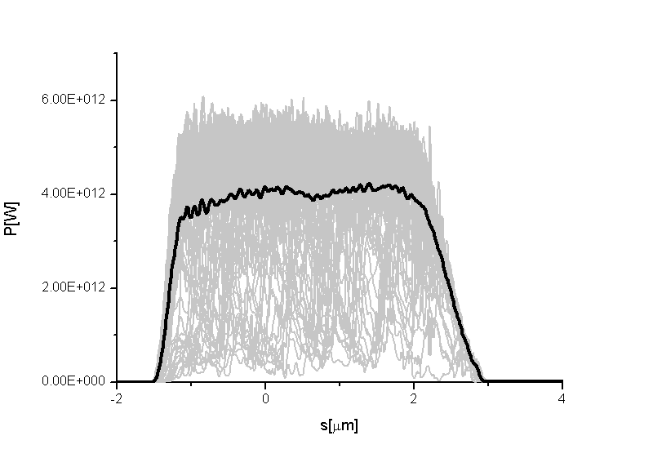
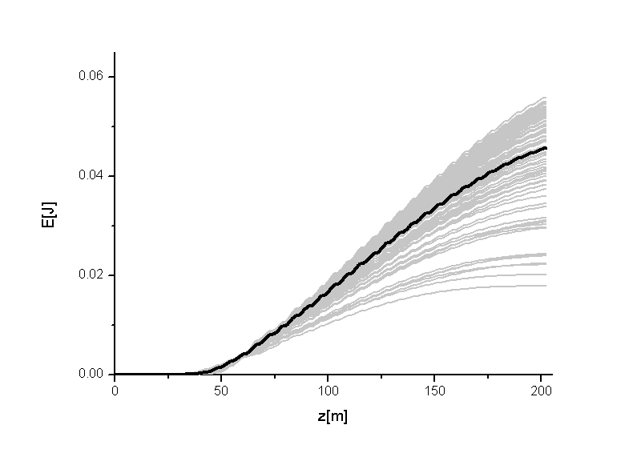
FEL simulations
Final output. Power after seeding and tapering
Final output. Energy of output pulses as a function on undulator length
The grey lines refer to single shot realization, the black line refers to the average over a hundred realizations

Slide 14
10 TW-power level undulator source. Conclusion
Exploiting start-to-end simulations of the European XFEl baseline, we demonstrate here that it is possible to achieve up to a 100-fold increase in peak power of the X-ray pulses: the X-ray beam would be delivered in 10 fs-long pulses with 50 mJ energy each at photon energy around 4 keV.
Parameters of the accelerator complex and the availability of long baseline undulators at the European XFEL offers the opportunity to build 10 TW-power level source with additional cost only about 2 MEUR

Slide 15
Critique of present European XFEL layout
However, the present layout of the undulator sources and of the SPB beamline does not allow for a successful exploitation of such potential.
In fact, due to the very long distance between the source and the SPB instrument (about 1 km) one suffers major diffraction effects, leading to 100-fold decrease in fluence at photon energy 3 keV, ideal for single bio-molecular imaging

Slide 16
European XFEL layout (from TDR 2006)
XFEL Photon Beam Transport Systems
Electron tunnel
MID
Undulator
HED
Photon tunnel
XTD6
XTD7
U 2
XSDU1
SASE 2
XS2
XS4
XTD8
XTD1
U 1
LINAC
XTD2
XS3
XTD9
SPB
FXE
SASE 1
SASE 3
SQS
XSDU2
SCS
XTD10
Electron switch
Electron bend
Electron dump

Slide 17
Comments to the original European XFEL layout
The original design of the European XFEL was optimized to produce FEL radiation at 0.1 nm, simultaneously at two undulator lines, SASE1 and SASE2.
Additionally, the design included one FEL line In the soft X-ray range, SASE3, and two indulator lines for spontaneous synchrotron radiation, U1 and U2.
The soft X-ray SASE3 beamline uses the spent electron beam from SASE1,
and U1 and U2 beamlines uses the spent beam from SASE2 (afterburner
mode of operation)

Slide 18
Current European XFEL layout
XFEL Photon Beam Transport Systems
Electron tunnel
MID
Undulator
HED
Photon tunnel
XTD6
XTD7
XSDU1
XTD5
SASE 2
XS2
XS4
XTD8
XTD1
XTD3
XTD2
XS3
XTD9
SPB
LINAC
FXE
SASE 1
XTD4
SASE 3
XSDU2
SQS
XTD10
SCS
Electron switch
Electron bend
Electron dump

Slide 19
Comments to current European XFEL layout
The layout of the European XFEL changed (about three years ago). In the last years after the achievement of the LCLS it became clear that the experiments with XFEL radiation, rather than with spontaneous radiation, had to be prioritized. In the current design, two undulator tunnels behind SASE2 are now free for XFEL undulators installation.
Cancelation of two undulators radically changed original design and availability of free undulator tunnels opened a possibility for optimization of sources and instruments positions at the fixed cost and time constrains.
Up to now the layout of SASE1, SASE2, and SASE3 undulators has not changed compared to the 2006 design

Slide 20
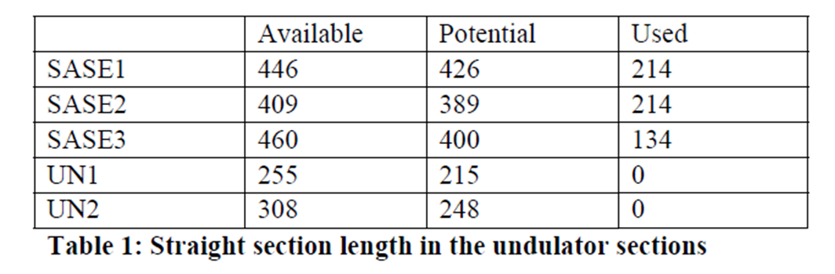
European XFEL undulator tunnel lengths
Tunnel lengths (m)
Available = Straight line defined by upstream/downstream bend
Potential = Accounts for electron beam optics requirements
Used = Up to now
Courtesy of W. Decking

Slide 21
Comments to table of undulator tunnel lengths
Length of XTD4 (SASE3) tunnel (400 m) is the same as the main SASE1 and SASE2 tunnels and more than sufficient for SASE1 undulator installation. The lengths of these undulator tunnels on the official layout sketch are out of scale.
Length of free U2 (XTD5) undulator tunnel (248 m) is more than sufficient for an installation of a (130 m long) soft X-ray SASE3 undulator
Plan to install soft X-ray SASE3 undulator to 400 m long tunnel (which can be used for 10 TW X-ray undulator source installation) do not seem logical, since this narrows down the possibilities for future European XFEL development. It may be wise to consider a relocation of the SASE3 undulator to a shorter undulator tunnel.

Slide 22
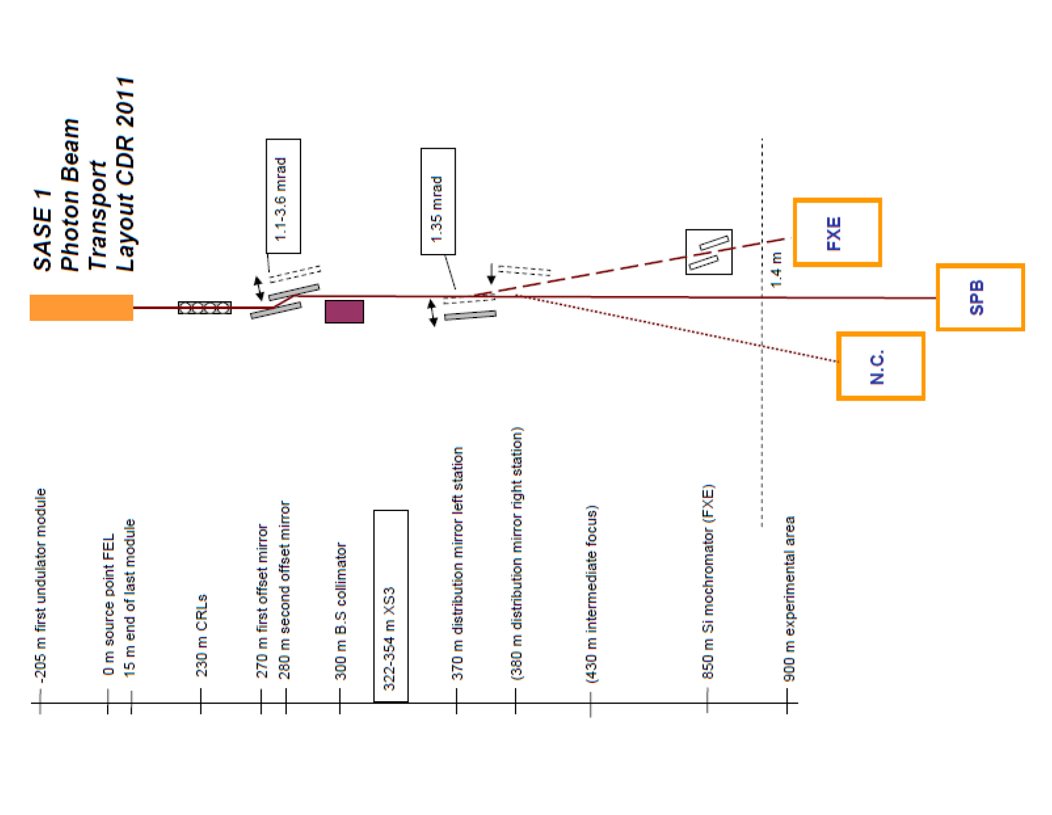
Present layout of SASE1 source and of the SPB beamline
Source: H. Sinn et al., X-ray Optics and Beam Transport Conceptual Design Report,
April 2011

Slide 23
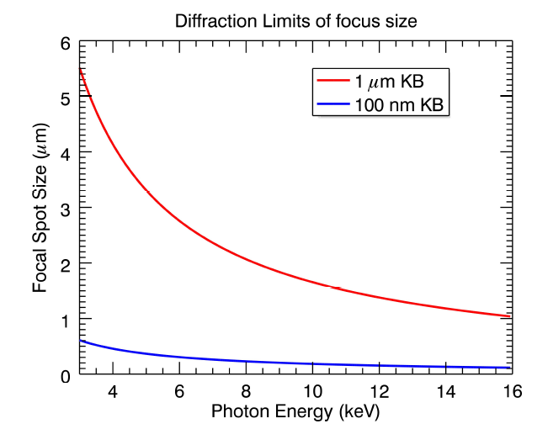
Focal spot size for SPB
Diffraction-limited focal spot-size due to lateral numerical aperture size for SPB
Source: A. Mancuso et al., SPB Technical Design Report, 2013

Slide 24
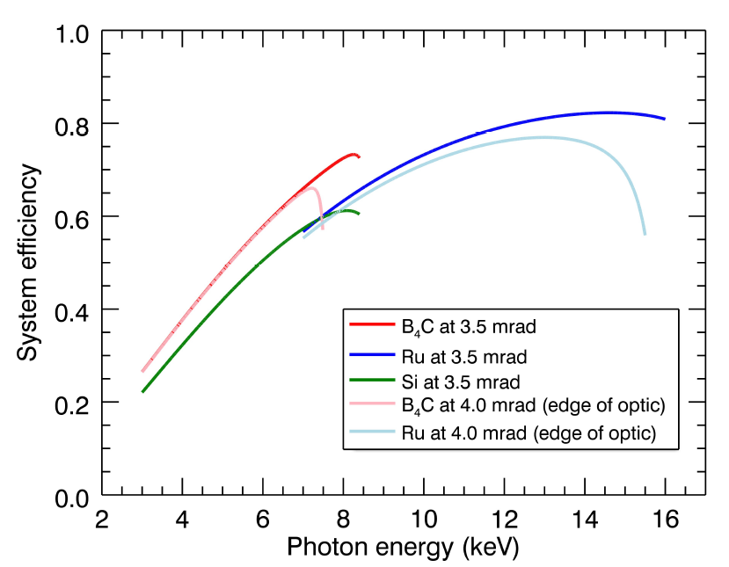
Overal system efficiency for the 100 nm focus at SPB
Overall system efficiency for the 100 nm focus at SPB
Source: A. Mancuso et al., SPB Technical Design Report, 2013

Slide 25
Comments to present position of SPB beamline
Diffraction-limited focal spot size increases from 100 nm at 16 keV to 600 nm at 3 keV
Overall system efficiency for 100 nm focus decreases from 80% at 16 keV down to 20 % at 3 keV
Opening angle of FEL radiation at 3 keV leads to unacceptable mirror length due to long distance of 900 m between the source and mirror system. There is no possibility to provide high focus efficiency at 3 keV photon energy with commercially available (90 cm-long) mirrors

Slide 26
Optimization of undulator and instrument positions
The availability of free undulator tunnels at the European XFEL offers the opportunity to build a beamline optimized for single bio-molecular imaging, thus enabling full exploitation of the 10 TW-power level source

Slide 27
Optimized European XFEL configuration: 1st variant
XFEL Photon Beam Transport Systems
Electron tunnel
MID
Undulator
HED
Photon tunnel
XTD6
XTD7
SQS
SASE 3
XSDU1
SCS
SASE 2
XS2
XS4
XTD8
XTD1
XTD3
XTD2
XS3
XTD9
LINAC
SASE 1
SPB
Advantages:
SASE1 source-sample distance reduced
from 900 m to 350 m
World leading bio-imaging facility from very
beginning of EXFEL operation
XTD10
FXE
Electron switch
Electron bend
Electron dump

Slide 28
Optimized European XFEL configuration: 2nd variant
XFEL Photon Beam Transport Systems
Electron tunnel
MID
Undulator
HED
Photon tunnel
XTD6
XTD7
SQS
XSDU1
SCS
XTD5
SASE 2
XS2
XTD3
XS4
XTD8
XTD1
SASE 3
LINAC
XTD2
XS3
SPB
FXE
SASE 1
XTD4
Empty 400 m-long
tunnel for dedicated
bio-imaging beamline
Cost of additional (40 cells)
undulator ~20 MEUR
and beamline ~10 MEUR
BIO
XTD10
Electron switch
Electron bend
Electron dump

Slide 29
Comments to 2nd variant of optimized layout
Soft X-ray SASE3 beamline from very beginning installed in U2 beamline
With extra (~30 MEUR) cost free XTD4 tunnel can be used for dedicated bio-imaging beamline development as proposed in DESY print DESY-12-086 (www.arxiv.org/abs/1205.6345) and DESY-12-156 (www.arxiv.org/abs/1209.5972)
Advantage compared to 1st variant:
Development from very beginning dedicated (without FXE instrument) bio-imaging beamline which will operate from water window (0.3 keV) to selenium K-edge (12.6 keV)
Disadvantage compared to 1st variant:
Significant additional cost and longer time for building a 10 TW undulator source and photon beamline

Slide 30
Optimized European XFEL configuration: 3rd variant
XFEL Photon Beam Transport Systems
Electron tunnel
MID
Undulator
HED
Photon tunnel
XTD6
XTD7
XSDU1
XTD5
SASE 2
XS2
XS4
XTD8
XTD1
XTD3
XTD2
XS3
XTD9
SPB
FXE
SASE 1
XTD4
SASE 3
New
bio-Instr.
Electron switch
New design of SASE3
photon beamline
Extension of SASE3
undulator from 21 to 40 cells
for 10 TW mode of operation
SCS
Electron bend
SQS
Electron dump

Slide 31
Comments to 3rd variant of optimized layout
Advantage compared to the 2nd variant:
Minimum layout changes and lower additional cost which need to start single bio-molecular imaging: only SASE3 photon beamline should be redesigned and SASE3 undulator extended from 21 cells to 40 cells
Disadvantages compared to the 2nd variant:
Limiting space for new bio-imaging instrument at SASE3 beamline
Interference with soft X-ray mode of operation

Slide 32
Conclusions I
From all applications of XFELs for life science the main expectation and the main challenge is the determination of 3D structures of biomolecules and their complexes from diffraction images of single particles
Only two facilities, European XFEL and LCLS-II, have the possibility to build a beamline suitable for single bio-molecular imaging: In the next decade, no other infrastructure will have such long undulators (- 250 m) and high electron beam energy (~ 13-17 GeV) for 10 TW mode of
operation with 10 fs long pulses
In 2012 LCLS-II design was updated to include a multi-TW undulator source optimized for single bio-molecular imaging. Self-seeding and undulator tapering improves FEL efficiency. Length of undulator tunnel now is significantly increased and hard X-ray undulator system now can be extended from 20 up to 60 cells. Due to the short distance between the source and a sample there is no problem associated with the low focus efficiency as we observe with the current SPB instrument

Slide 33
Conclusions II
Proposed here cost-effective upgrade program gives the possibility to build a beamline optimized for single bio-molecular imaging bringing European XFEL to a world-
leading position in this field
With the present design we risk that the structural and cellular biology community will use the European XFEL for test purpose only while at the same time applying for real experiments to the bio-imaging beamline at the LCLS-II

